Slide 1
Wandering in Woods Game
Presented By:
Mani Ratnam Kasoju
Praveen Thumati
Vamshi Reddy Musku
Venkata Ramana Patnam

Slide 2
INTRODUTION
The thirst for new games in the market has increased.
The Wandering in the Woods Game is a fun filled multiplayer game. It can be played by many players individually.
This game could also improve statistics calculations and math calculation in student sector.

Slide 3
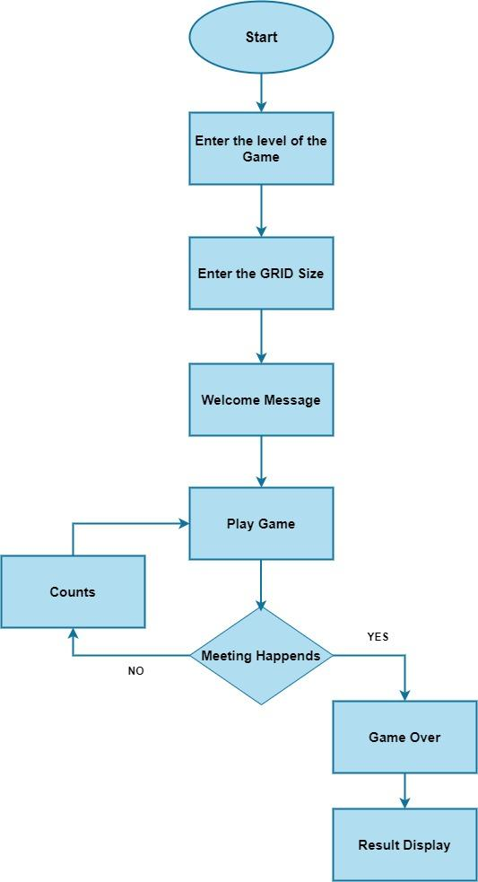
Overview of wandering in woods game

Slide 4
Specification
Java – Programming language is used.
This is not a single player game.
More than one player game with a limitation of 8 players max.
An interesting game with 3 levels.
2 players
Upto 5 players
Maximum of 8 players.

Slide 5
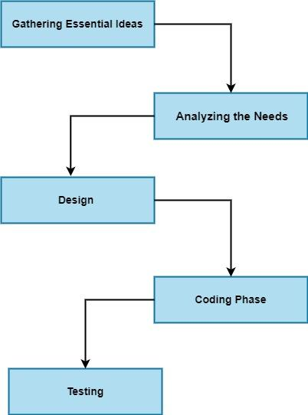
Model Selection
Water fall model
Sequential approach

Slide 6
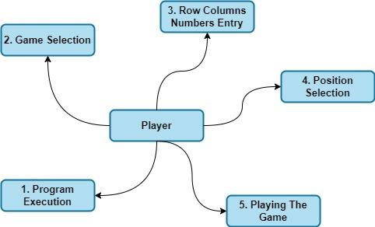
Use case
Grade | K-2 | Grade 3-5 | Grade 6-8
Player count | 2 | 2 to 5 | 2 to 8
Grid type | Square | Rectangle | Rectangle
Grid size | Player choice | Player choice | Player choice
Calculation | statistics | statistics | statistics

Slide 7
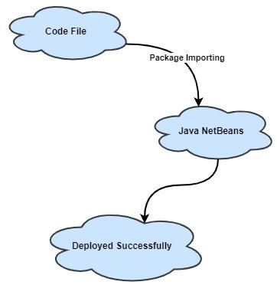
Deployment and testing
Deployment
Testing
- The developed code file is imported into netbeans and executed to run the program.
Integration
Usability
Validation

Slide 8
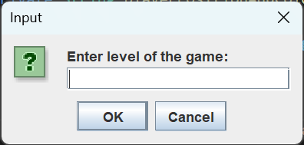
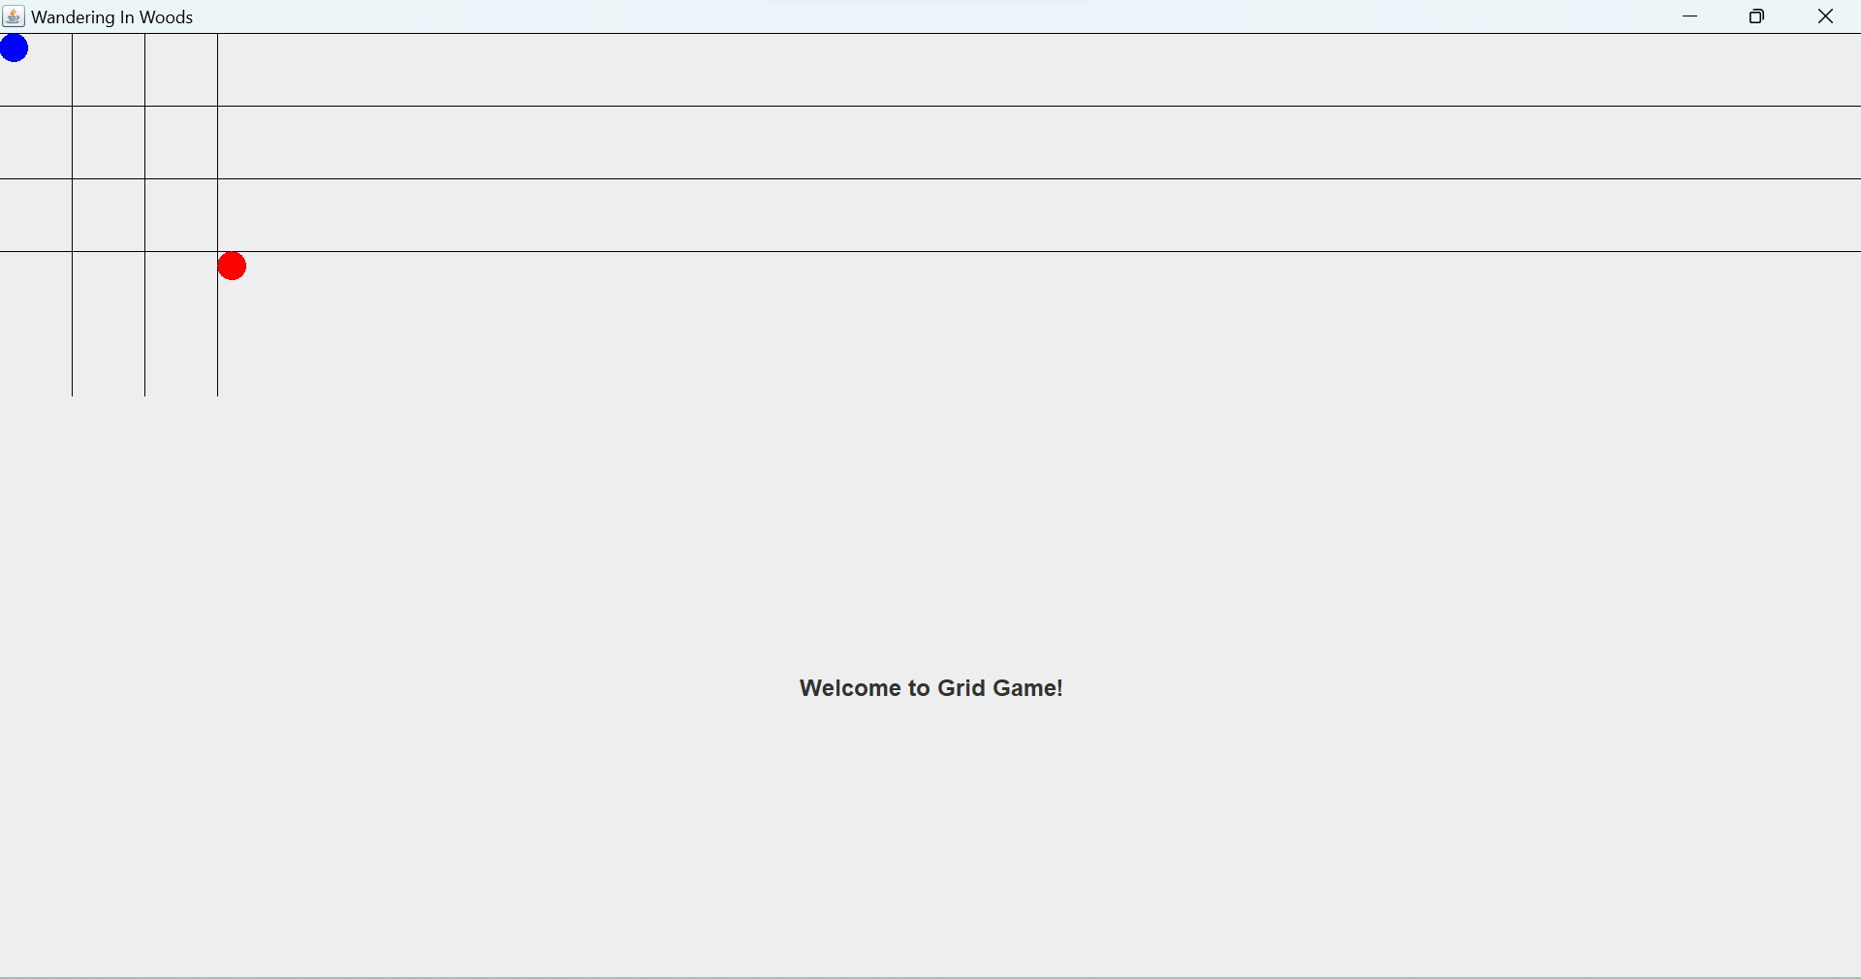
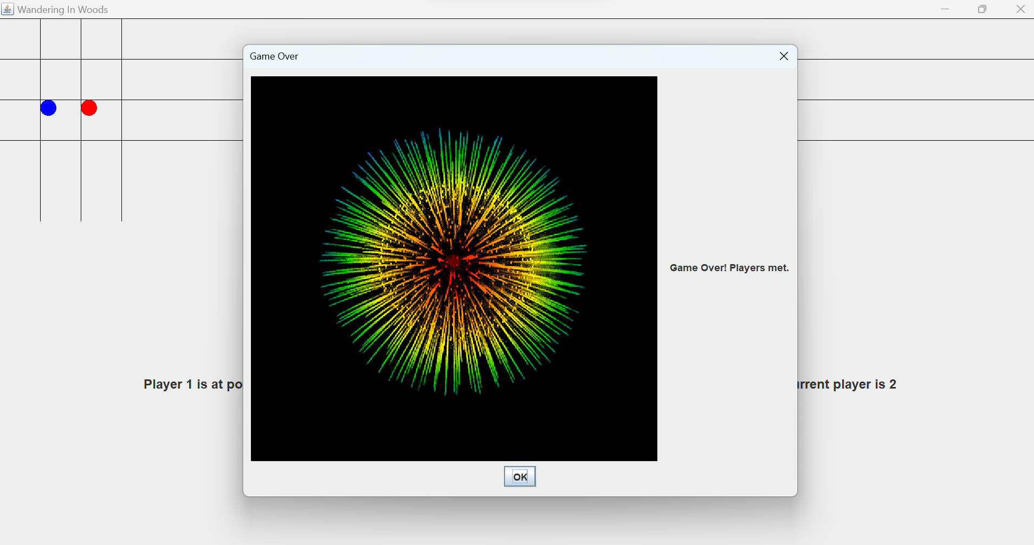
Output Screens of Grade k2

Slide 9
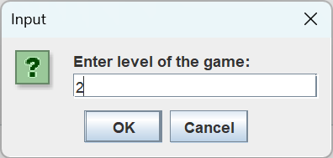
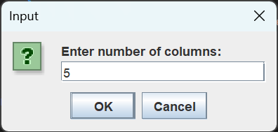
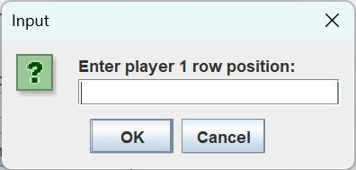
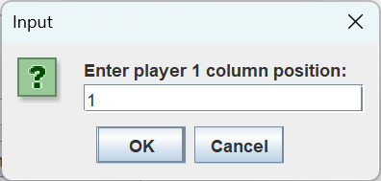
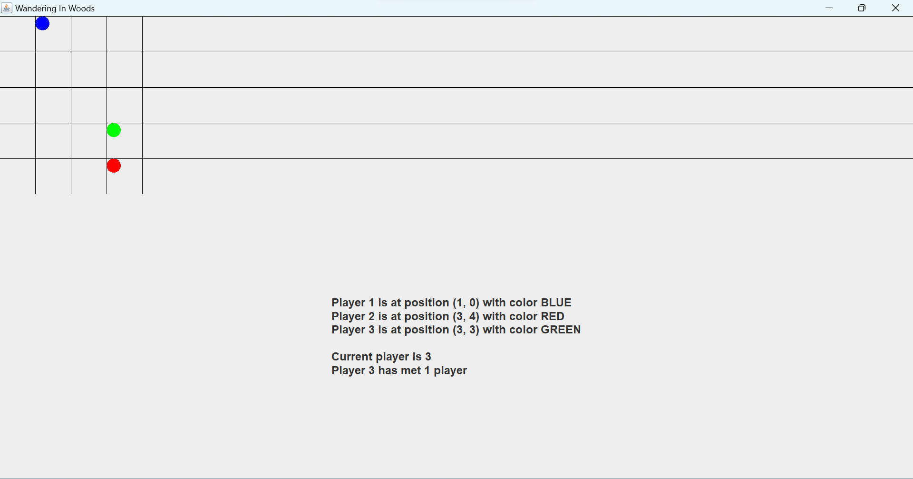
Output Screens of Grade 3-5

Slide 10
Grade 6-8

Slide 11
REFERENCES
Chiorri, C. (2023). The Role of Mindfulness, Mind Wandering, Attentional Control, and Maladaptive Personality Traits in Problematic Gaming Behavior. Mindfulness , 648-670.
Haraty, R. A. (2018). Software process models: A review and analysis. International Journal of Engineering & Technology, 325-331.
Koc, H. (2021). UML Diagrams in Software Engineering Research: A Systematic Literature Review. Proceedings , 1-10.
Nikiforova, O. (2011). Role of UML Class Diagram in Object-Oriented Software Development. Scientific Journal of Riga Technical University Computer Sciences, 65-74.
Rivero, J. M. (2010). From Mockups to User Interface Models: An Extensible Model Driven Approach. Conference: Current Trends in Web Engineering - 10th International Conference on Web Engineering, ICWE 2010 Workshops, Vienna, Austria, July 2010, Revised Selected Papers, 12-25.
Rosenbaum, M. S. (2016). How to create a realistic customer journey map. Business Horizons, 1-19.
Sawant, A. A. (2012). Software Testing Techniques and Strategies. International Journal of Engineering Research and Applications, 980-986.

